Slide 1
Day 4
Romeo and Juliet
A tragedy by William Shakespeare
Pick up an orange textbook.

Slide 2
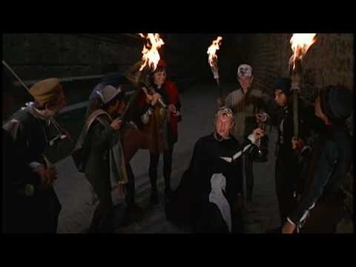
Act I R&J: Mercutio’s Queen mab speech

Slide 3
R&J PQQ #1: Literary Terms and Devices
You may use your Romeo and Juliet packet as your resource on this quiz.
Turn in your quiz to your block’s inbox when finished, and then complete the nine questions about insults in your packet.

Slide 4
Writing Focus for the R&J Unit
Patterns
Pattern #1: compare/Contrast
Tragedy v. Comedy Foil: Romeo v. Mercutio
Theme: Love and Family v. Hate and Enemies

Slide 5
Freytag
(Linear Narrative plot structure)
Act I = exposition
Act II = rising action
END OF COMEDY (MARRIAGE)
Act III = climax
Act IV = falling action (denoument)
Act V = resolution
TRAGEDY (DEATH)

Slide 6

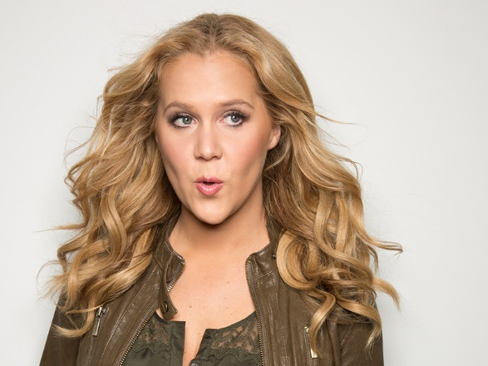
Why? Who? What? How?
Packet page!
Tragedy
Comedy
What do we need to know about the similarities and differences of tragedy and comedy in order to understand both so we can make sense of R&J?

Slide 7
Tiny group project
Create a Venn diagram or T-chart to summarize your group’s W-question
about tragedy and comedy in kid-friendly language.

Slide 8
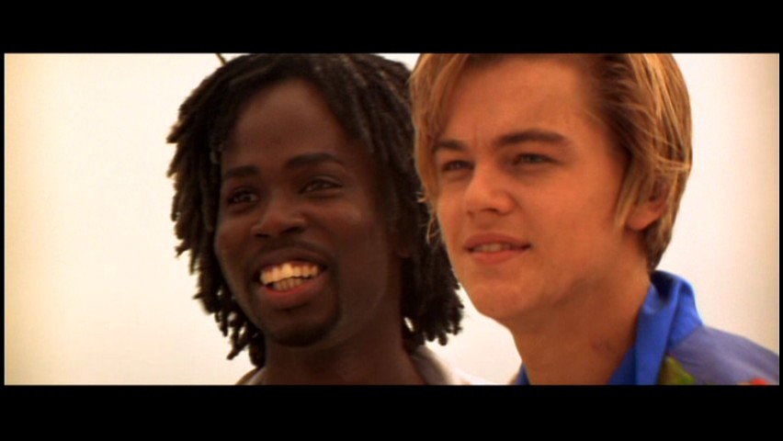
Characterization: Foil
Romeo
Mercutio
Tragedy
Conversation with Benvolio about pining away for Rosaline.
  Start Montague 117
Melancholy boy
Takes life very seriously.
Comedy
Queen Mab speech
Funny dreamer
Doesn’t take life too seriously.

Slide 9
Act I, sc i parts: Block 2
Sampson: Tristan
Gregory: Bishop
Abram: Andres
Benvolio: Sebastian
Tybalt: Joe P
Citizens: class
Lord Capulet
Lady Capulet
Lord Montague
Lady Montague
Prince Escalus
Romeo

Slide 10
Act I, sc i parts: Block 3
Sampson: Malachi
Gregory: Gabriel
Abram: Lori
Benvolio: Estevan
Tybalt: Morgan
Citizens: class
Lord Capulet
Lady Capulet
Lord Montague
Lady Montague
Prince Escalus
Romeo

Slide 11
Act I, sc i parts: Block 4
Sampson: William
Gregory: Michael
Abram: Jordan
Benvolio: Peter
Tybalt:Bri
Citizens: class
Lord Capulet
Lady Capulet
Lord Montague
Lady Montague
Prince Escalus
Romeo

Slide 12
Act I, sc i
orange textbook p. 993
Comedy and conflict
  Servants banter
  Double entendre
  Pun
Action
  Theme:
    feuds
    enemies
Mood shift: tragic
  Benvolio and Romeo
  Nature imagery
  Oxymoron
  Allusion
  Theme:
    love
    family

Slide 13
Objective: I will identify a theme and support it with quotes.
Formative Assessment #1
Take Notes! Apply Learning!
Write a paragraph in which you build a theme through cited evidence.
  MLA quote citation
  PEAL structure
  Transitions
  Mechanics
Thursday, March 23rd
Dialectical journal
Literary devices
Close read for key details
Pull effective quotes
Identify themes; write working thesis
Recognize patters (com/con)

Slide 14
Work on your homework: questions #1-5 for Act I.
Time remains, you say?

