Slide 1
Romeo and Juliet
A tragedy by William Shakespeare

Slide 2
Anticipation Guide
It is never right to kill another person.
Love is worth dying for.
Teenagers know what true love is.
It is more important to honor your family than to do what you want.
Love at first sight is real.
There is only one kind of love.
Everything happens for a reason.
Packet page!

Slide 3

Setting Priorities
As a class:
What are Atticus Finch’s priorities and values?
On your own:
What are your priorities?
Packet page!

Slide 4
Day 1: Theatre Background
Shakespeare’s theatre
  All roles were played by men; women were not allowed on stage
  Costumes:
    could be anything the actor wanted
    anachronistic (error in time)
  Scenery:
    very simple, if any
    Shakespeare had to write in nature imagery
    audience had to listen and use their imaginations.
    thus the importance of the Prologue
  Plays as blockbuster entertainment:
    90% of the audience was illiterate
    no tv, no radio, no books to read…the play was the ONLY thing
    Each play had to have love, death, violence, sex, humor…a bit of everything!

Slide 5
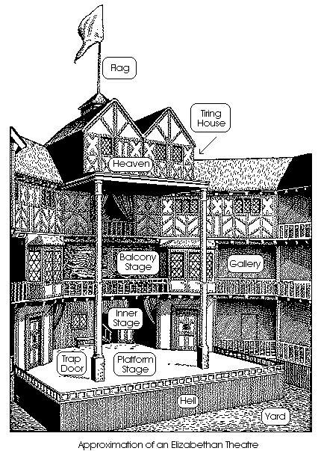
Day 1: Theatre Background cont.
  Groundlings
    Poor audience members
    Stood in the yard
    Got wet if it rained
    Rowdy! Vocal and would throw things if the play was bad
  The Globe
    Circular theatre with open top
      No electric lights!
    Royalty, nobility, and gentry could sit in covered balconies
    Famous history (burned and closed due to plague)

Slide 6
Day 1: Historical Background
Elizabethan England (1558-1603)
  Women
    Were considered property
    Were subservient to men (first father, then husband, and ultimately God)
    Marriage was arranged, typically by the time the girl was 15
    Problems between fathers and daughters are a recurring conflict in many of Shakespeare’s plays (Shakespeare often takes the daughter’s side)
  Plague
    The Bubonic plague, or Black Death, was virulent during Shakespeare’s life
    Death carts and quarantine; “plague houses”
  Religion and royalty
    dominated and maintained the social hierarchy
    If something bad happened, it was fated as God’s will.
    The royals had power above all but God.
    Servants of God (ministers, friars, etc.) were respected counselors

Slide 7
Complete the character chart in your packet. Notice the social hierarchy.
Romeo and Juliet
Character Chart
Packet page!

Slide 8
ShakesPeare Timeline
The first team to correctly answer all questions on the timeline earns an automatic 100% on our second R&J PQQ.
Packet page!

Slide 9
Scansion
Iambic pentameter
  5 feet per line
  2 syllables per foot
  Syllable pattern = unstressed (dee) / stressed (dum)
Shall I/ compare/ thee to/ a sum/mer’s day?
Packet page!

Slide 10
Language
Syntax
  The order of the words in a sentence
    Meaning is primarily tied to the subject and verb
  Yoda it up: Try you must!
Subject and predicate practice
  Subject: the noun or pronoun doing the action
  Predicate: the verb and its associates (adjectives, adverbs, prepositional phrases, etc)
Packet page!

Slide 11
Literary terms
Iambic pentameter
Soliloquy
Aside
Monologue
Foil
Irony
Double Entendre
Metaphor
Personification
Hyperbole
Alliteration
Simile
Foreshadowing
Diatribe
Oxymoron
Pun
Packet page!

