Slide 1
Romeo and Juliet
Their tragic end

Slide 2
Monday, April 17th, 2017
Homework
Answer Essential Question #3: How and why do writers use imagery?
Announcements
Friday’s PRA?
Turn in your homework (EQ #2 and #4) to your block’s inbox.
Agenda
Warm Up: Write a PEAL about Act III; choose one type of sequence to structure your paragraph.
Finish group mind map
Motifs in music
Juliet’s soliloquy
Finish the film: Romeo and Juliet Acts IV and V

Slide 3
Warm Up:
Write a PEAL about Act III. Choose one of the three types of sequence to structure your paragraph. Use your graphic organizer from last class as well as your mini-lesson to provide clarification, transitions, and evidence.
Write your PEAL on the back of your Act III organizer.

Slide 4
Mind maps and motifs
Task #1:
Finish your group’s mind map poster from last class.
Remember that it must be both artistic and legible.
Include Shakespeare’s insight and your group definitions.
Hang your poster on the back wall of the classroom.
Task #2:
Check out the group mind maps to make sure you understand each topic.
Pick up a copy of the handout under the Smartboard.
Find examples of the mind map topics in your music and record them on your chart. Include the artist, song title, and line.

Slide 5
Act IV, sc iii: Juliet’s soliloquy
Close read and annotate Juliet’s lamentation. Close read for imagery and strong diction.
Annotate using the mind map topics.
When you finish, notice whether a pattern of meaning is revealed. What is this soliloquy really about?

Slide 6
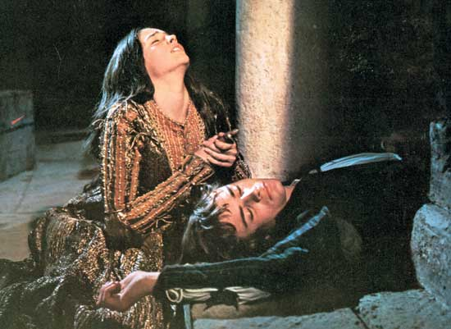
Finish watching film
Acts IV and V
1:45-2:18

