Slide 1
Day 6
Romeo and Juliet
A tragedy by William Shakespeare
Pick up an orange textbook.

Slide 2
PQQ #2: Background
Name one of the reasons theatres were closed during Shakespeare’s time.
Who was the royal ruler of England during Shakespeare’s life?
Name Shakespeare’s famous theatre.
What was notable about Shakespeare’s wife?
Name the three men to whom a woman might belong during her lifetime.
List, in order, the top two tiers of the social hierarchy in Shakespeare’s world.
Directions:
On your own paper, answer the following questions.
Answers do NOT need to be in complete sentences.
Turn your paper in to your block’s inbox when finished.

Slide 3
Writing Focus for the R&J Unit
Patterns
Pattern #1: compare/Contrast
Tragedy v. Comedy Foil: Romeo v. Mercutio
Theme: Love and Family v. Hate and Enemies

Slide 4
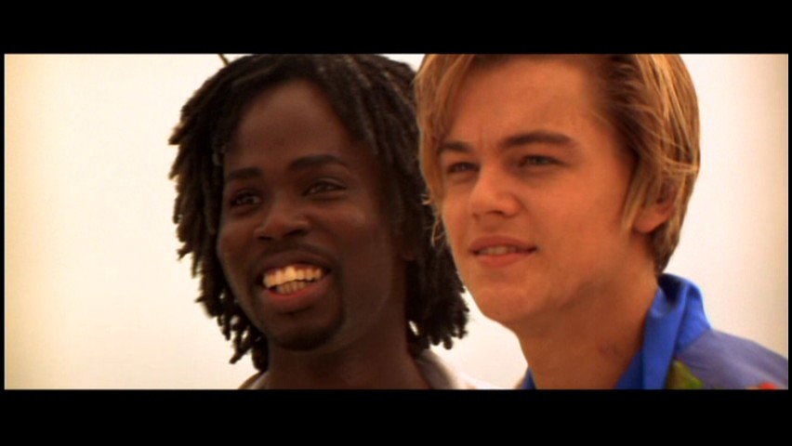
Compare/Contrast
Characterization: Foil
Romeo
Mercutio
Tragedy
Conversation with Benvolio about pining away for Rosaline.
Melancholy boy
Takes life very seriously.
Comedy
Queen Mab speech
Funny dreamer
Doesn’t take life too seriously.

Slide 5
Zeffirelli Film of R&J
Begin watching the film.
Answer study guide questions.
Create a dialectical journal in the Reading Section of your Writer’s Notebook.
During the film, take notes in your dialectical journal. Focus on 5W’s and H.
You may use your notes and packet on Thursday’s Formative Assessment, so it is in your best interest to stay engaged.

Slide 6
R&J Dialectical Journal
Quote/Detail (include speaker) | Literary Element | Thematic Concept | Commentary
“Bid a sick man in sadness make his will:/ Ah, word ill urged to one that is so ill!/ In sadness, cousin, I do love a woman” (Shakespeare 1.1. 187-190). | Characterization | The intensity of teenagers’ emotions may be psychosomatic (the mind’s physical manifestation). | Romeo’s word choice directly characterizes him as a dramatic, melancholy teen who is practically sick for Rosaline.

Slide 7
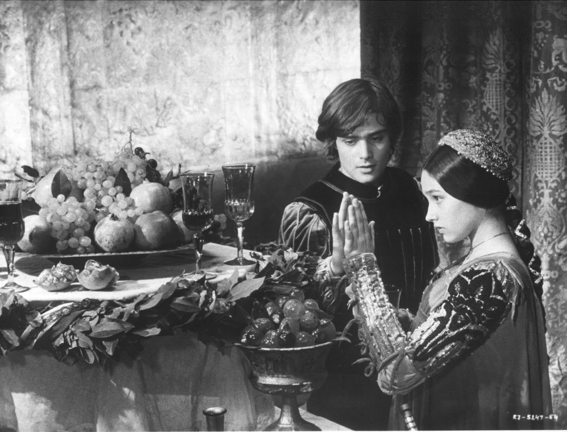
Watch the movie

Slide 8
Objective: I will identify a theme and support it with quotes.
Formative Assessment #1
Take Notes! Apply Learning!
Write a paragraph in which you build a theme through cited evidence.
  MLA quote citation
  PEAL structure
  Transitions
  Mechanics
Thursday, March 23rd
Dialectical journal
Literary devices
Close read for key details
Pull effective quotes
Identify themes; write working thesis
Recognize patterns (com/con)

