Slide 1
Day 3 Romeo and Juliet
A tragedy by William Shakespeare

Slide 2
Warm Up
Finish scansion of Sonnet 18 in your Romeo and Juliet packet.
Identify the simple subject and simple predicate in each line.

Slide 3
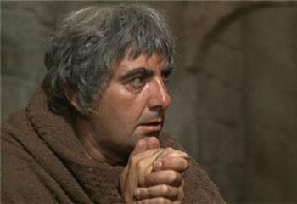
Friar’s Figurative Language
Homework check

Slide 4
Freytag (Linear Narrative plot structure)
Act I = exposition
Act II = rising action
END OF COMEDY (MARRIAGE)
Act III = climax
Act IV = falling action (denoument)
Act V = resolution
TRAGEDY (DEATH)

Slide 5
Romeo and Juliet
Close read and annotate the synopsis of the play in your packet.
Packet page!

Slide 6
Packet page!

Slide 7
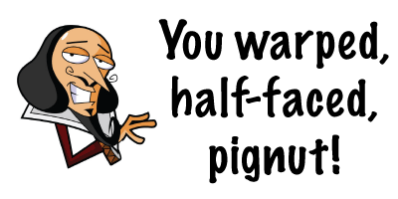
Shakespearean insults
Packet page!
Time to roast your classmates and your teacher, Shakespeare style!

Slide 8
Act I, sc i
Comedy and conflict
Servants banter
Double entendre
Action
Theme:
feuds
enemies
Mood shift: tragic
Benvolio and Romeo
Nature imagery
Oxymoron
Theme:
love
family

Slide 9
Act I, sc i parts
Sampson
Gregory
Abram
Benvolio
Tybalt
Citizens
Lord Capulet
Lady Capulet
Lord Montague
Lady Montague
Prince Escalus
Romeo

